Slide 1
The life of a snail
By Grace O’Connor

Slide 2
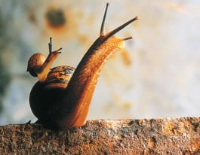
Snails
A snail is an animal with a soft body often covered with a shell.
A snail creeps along on an organ called a foot.
Its head has feelers, eyes, mouth and teeth.
Most snails live from 2 to 5 years, but in captivity, some have exceeded 10 or 15 years of age.

Slide 3
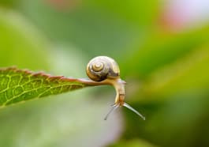
Where they live
Snails live in forests, deserts, rivers, ponds and all parts of the 0cean.

Slide 4
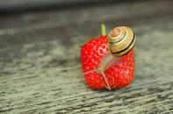
What they eat
They eat many kinds of food, including plants and animal remains.
They love seedlings and thick-leaved plants, along with fruits and vegetables.

Slide 5
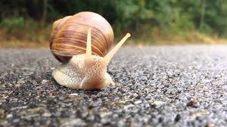
How they move
Snails move by gliding on their muscular foot.
The speed of snails is around 0.5-0.8 inches per second.
If they moved without stopping, it would take more than a week to complete 1 kilometer.

Slide 6
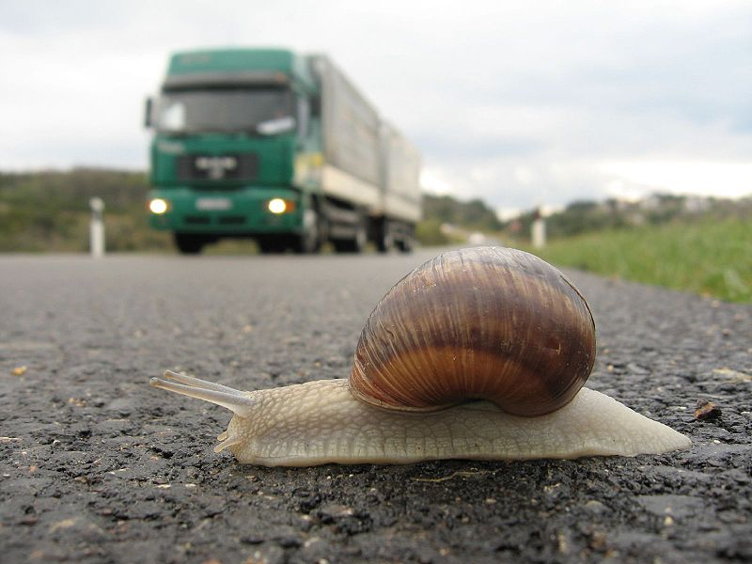
Dangers they face
When they feel threatened, they usually retreat into their shell to protect themselves.
Snails have a large number of predators e.g. Birds and mammals.
Snails also eat each other.
Road traffic.

